Slide 1



science

Slide 2
science
Exam board: Edexcel
Courses:
      combined course – mandatory
      Separate course – chosen as one of your 4 options

Slide 3
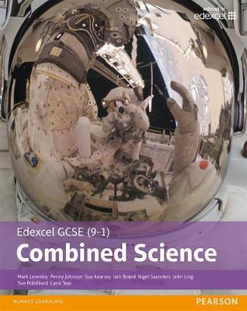
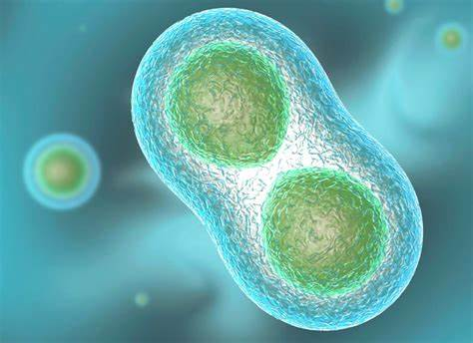
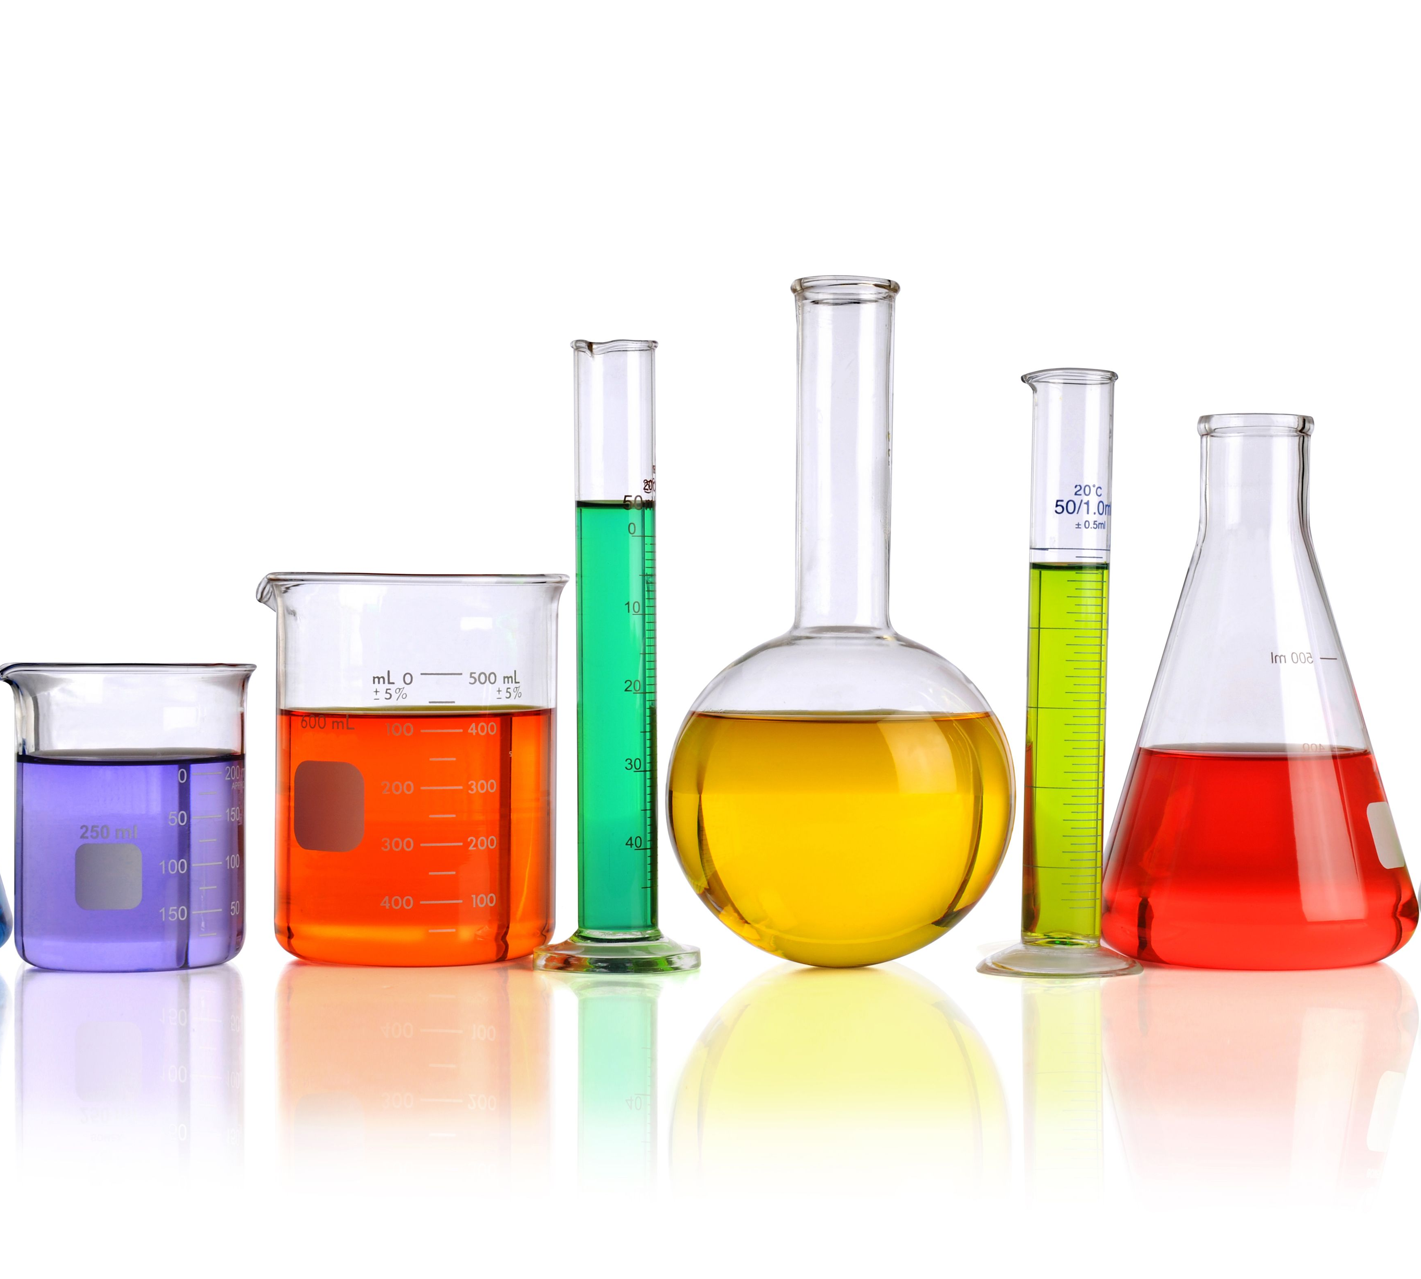

Combined science
Biology
CB1- Key Concepts in Biology
CB2- Cells and Control
CB3- Genetics
CB4- Natural Selection and Genetic Modification
CB5- Heath, Disease and the Development of Medicines
Chemistry
CC1 & 2 States of Matter & Purifying Substances
Physics
CP1 Motion
CB6- Plant Structures and their Functions
CB7- Animal Coordination, Control and Homeostasis
CB8- Exchange and Transport in Animals
CB9- Ecosystems and Material Cycles
CC3 Atomic Structure
CC4 The Periodic table
CC5, 6, 7 Ionic Bonding, Covalent Bonding, Types of Substance
CC8 Acids & Alkali’s
CC9 Calculations Involving Masses
CC10, 11, 12 Electrolytic Processes, Extracting Metals, Reversible Reactions & Equilibria
CC13, 14, 15 Groups in Periodic Table, Rates of reaction & Heat Energy Changes
CC16-17 Fuels & Atmospheric Science
CP14/15 Particle Model/Forces and Matter
CP12/13 Magnetism and the Motor Effect/EM Induction
CP10 Electricity and Circuits
CP8/9 Energy/Forces Doing Work
CP6 Radioactivity
CP5 Light and the Electromagnetic Spectrum
CP4 Waves
CP3 Conservation of Energy
CP2 Motion and Forces

Slide 4
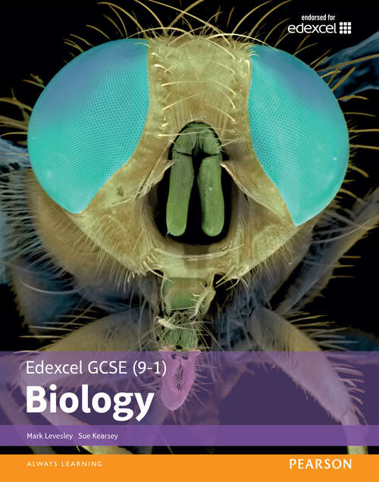
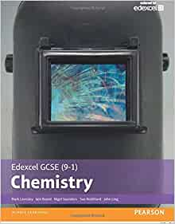
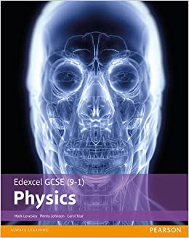
Separate science
Biology
SB1 Key Concepts: Cells, Enzymes & Transporting substances
Chemistry
SC1 & 2 States of Matter & Purifying Substances
Physics
SP1 Motion: distance, velocity, acceleration
SC3 Atomic Structure
SC4 The Periodic table
SC5, 6, 7 Ionic Bonding, Covalent Bonding, Types of Substance
SC8 Acids & Alkali’s
SC9 Calculations Involving Masses
SC10, 11, 12, 13 Electrolysis, Obtaining & Using Metals, Reversible Reactions (Equilibria), Transition Metals, Alloys & Corrosion
SC14, 15 ,16 Quantitative Analysis, Dynamic Equilibria, Calculations Involving volumes of gases, Chemical Cells & Fuel cells
SC17, 18, 19 Groups in Periodic table, Rates of Reaction, Heat energy Changes in Chemical Reactions
SC20, 21 Fuels, Earth & Atmospheric Science
SC22, 23, 24 Hydrocarbons, Alcohols & Carboxylic Acids, Polymers
SC25, 26 Qualitative tests for Ions, Bulk & Surface properties of Matter
SB2 Mitosis, Growth & Nerves
SB3 Genetics: DNA, Inheritance & Variation
SB4 Human Evolution, Natural selection, Breeds & Varieties
SB5 Health, Disease and Medicines
SB6 Photosynthesis & Transport in Plants
SB7 Hormones and Homeostasis
SB8 Heart, Circulatory system and Cell Respiration
SB9 Ecosystems and Material cycles
SP2 Motion and Forces: Newton’s Laws, momentum
SP3 Conservation of Energy: Energy types and transfers
SP4 Waves: Describing waves, wave behaviours, sound
SP5 Light and the Electromagnetic Spectrum: The types of light and their uses
SP6 Radioactivity: The atom, radiation, energy
SP8/9 Energy/Forces Doing Work: Energy Transfers, Types of Forces
SP10/11 Electricity and Circuits/Static Electricity: Building and describing circuits, quantifying electricity, Charge transfers
SP12/13 Magnetism and the Motor Effect/EM Induction: Types of Magnets, Uses of Induction, The National Grid
SP7 Astronomy: Describing what’s in space
SP14/15 Particle Model/Forces and Matter: Energy in Particles, Springs, Fluids

Slide 5
Why choose separate science?
If you are interested in Neuroscience, Astronomy & Space science, Materials Science and nanoparticles, you will study these in separate science. These topics are very interesting and if you are planning on taking a science A level, it is a really good base to work from.
More core practical's for Separate science (24 compared to 18) which makes it more of a ‘hands on’ subject.

Slide 6
Why choose separate science?
If science is one of your favourite subjects then you should consider taking separate science.
You will enjoy the opportunity to spend 13 hours a fortnight doing science and the opportunity to explore Biology, Chemistry, Physics in more depth.
Separate science is good preparation for studying science at A level

Slide 7


