Slide 1
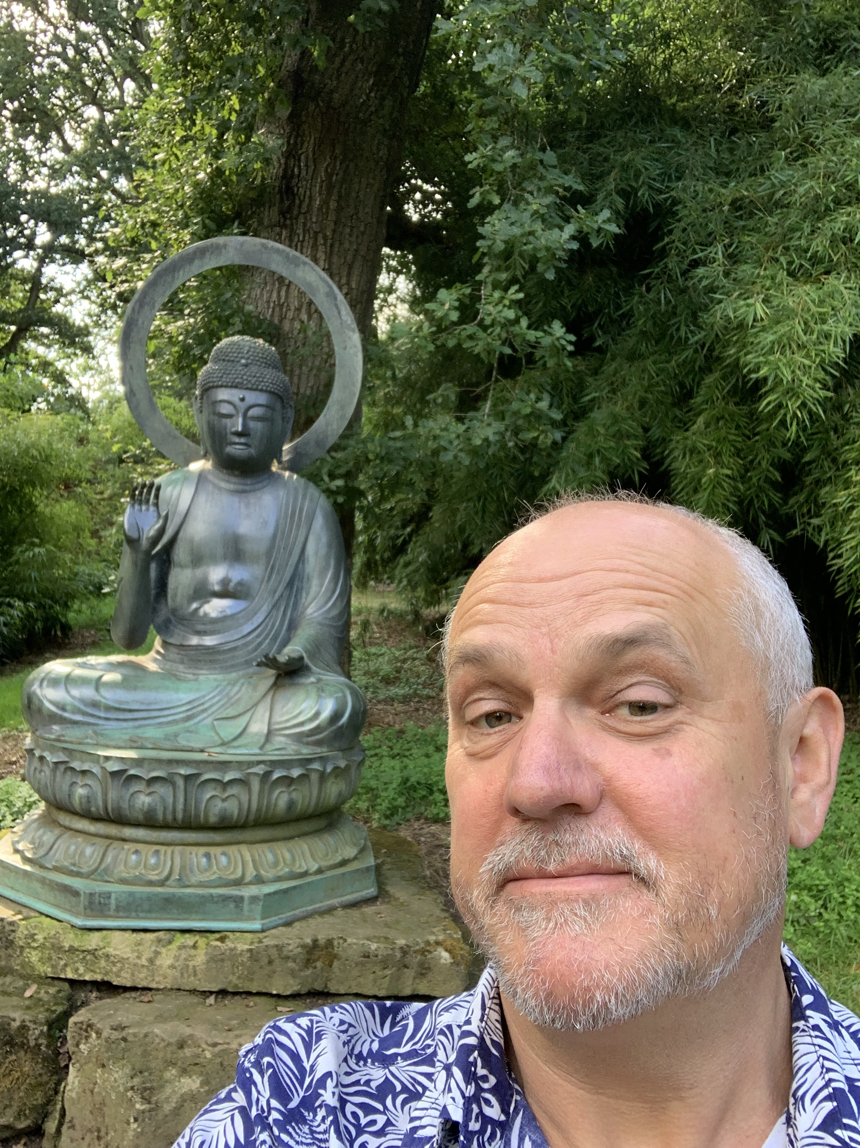
GCSE Religious Studies
Taking a RS GCSE helps you learn about how religion, philosophy, and ethics form the basis of our culture. It also encourages you to develop a set of ethical and moral beliefs. It can also help you see 'the bigger picture or understand why some topics can be so highly policed and politicised. This understanding and curiosity about the world can open the door (and career path!) to other subjects such as sociology, political science, anthropology, language studies, classical studies and history.
And finally, if you're still stuck on deciding whether the RS GCSE is the right choice for you, know that throughout taking the GCSE you'll develop analytical and critical thinking skills, the ability to work with abstract ideas, leadership and research skills. All these skills will help prepare you for further study.

